Slide 1
Soft Computing
by
Dr. Pratik Roy

Slide 3
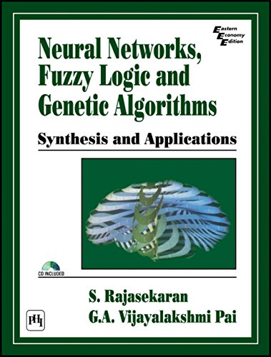

Slide 4
Concept of Computing
Y = f(x), f is a mapping function
f is also called a formal method or an algorithm to solve a problem.

Slide 5
Important Characteristics
Should provide precise solution.
Control action should be unambiguous and accurate.
Suitable for problem, which is easy to model mathematically.

Slide 6
Hard Computing
In 1996, LA Zadeh introduced the term hard computing.
According to Zadeh: We term a computing as "Hard" computing, if
Precise result is guaranteed
Control action is unambiguous
Control action is formally defined (i.e. with mathematical model
Example:
Solving numerical problems (e.g. Roots of polynomials, Integration etc.)
Searching and sorting techniques
Solving "Computational Geometry" problems (e.g. Shortest path in Graph theory, Finding closest pair of points etc.)

Slide 7
Hard Computing
Hard computing is a traditional computing.
It requires a precisely stated analytical model and usually a lot of computation time.
It strictly follows known steps to solve a task as opposed to soft computing which is heuristic in nature.
The principles of hard computing are precision, certainty and rigor.
Hard computing is achieved using sequential programs that use binary logic.
It is deterministic in nature. The input data should be exact and the output will be precise and verifiable.

Slide 8
Problems in some other areas of applications
Medical diagnosis
Person identification / Computer vision
Hand written character recognition
Pattern recognition and Machine Intelligence
Weather forecasting
VLSI design
Network optimization

Slide 9
Hard Computing
Advantages
Accurate solutions can be obtained
Faster
Disadvantages
Not suitable for real world problems
Cannot handle imprecision and partial truth

Slide 10
Soft Computing
Soft computing is the reverse of hard (conventional) computing.
It refers to a group of computational techniques that are based on artificial intelligence (AI) and natural selection.
It provides cost-effective solutions to the complex real-life problems for which hard computing solution does not exist.
The term "soft computing" was coined by Lotfi A. Zadeh.
Soft computing is a set of algorithms, including neural networks, fuzzy logic, and genetic algorithms.
These algorithms are tolerant of imprecision, uncertainty, partial truth and approximation.
It is contrasted with hard computing: algorithms which find provably correct and optimal solutions to problems.

Slide 11
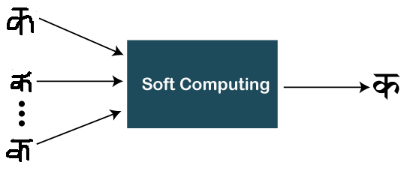
Soft Computing
Objective of soft computing is to provide precise approximation and quick solutions for complex real-life problems.
An emerging approach that gives the amazing ability of the human mind

Slide 12
Characteristics of Soft Computing
It does not require any mathematical modeling of problem solving
It may not yield the precise solution
Algorithms are adaptive (i.e. it can adjust to the change of dynamic environment)
Use some biological inspired methodologies such as genetics, evolution, Ant's behaviors, particles swarming, human nervous systems etc.

Slide 13
Components of Soft Computing
Principle components of soft computing
Artificial Neural Network (ANN)
Fuzzy Logic (FL)
Genetic Algorithm (GA)

Slide 14
Goals of Soft Computing
Main goal of soft computing is to develop intelligent machines to provide solutions to real world problems, which are not modelled, or too difficult to model mathematically.
It’s aim is to exploit the tolerance for Approximation, Uncertainty, Imprecision and Partial Truth in order to achieve close resemblance with human like decision making.

Slide 15
Soft Computing vs. Hard Computing
Soft Computing | Hard Computing
Soft Computing is liberal of inexactness, uncertainty, partial truth and approximation. | Hard computing needs a exactly stated analytical model.
Soft Computing relies on formal logic and probabilistic reasoning. | Hard computing relies on binary logic and crisp system.
Soft computing has the features of approximation and dispositionality. | Hard computing has the features of precision and categoricity.
Soft computing is stochastic in nature. | Hard computing is deterministic in nature.
Soft computing works on ambiguous and noisy data. | Hard computing works on exact data.
Soft computing can perform parallel computations. | Hard computing performs sequential computations.
Soft computing produces approximate results. | Hard computing produces precise results.
Soft computing will emerge its own programs. | Hard computing requires programs to be written.
Soft computing use multi-valued logic. | Hard computing uses two-valued logic.

